Slide 1
An Introduction to the R Programming Language
Lesson 1
Intro to R and R Studio

Slide 2
Course Introduction

Slide 3
Objectives
Use R to perform analyses of laboratory operational data
Adopt a 'tidy' approach to data analysis within the framework of R
Leverage R as a means of improving reproducibility in your clinical data analysis

Slide 4

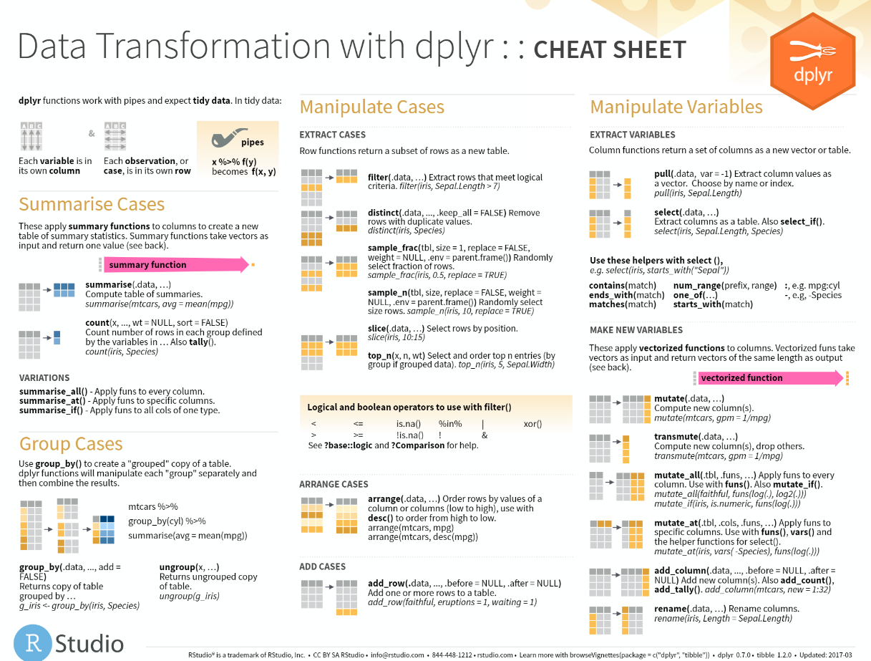
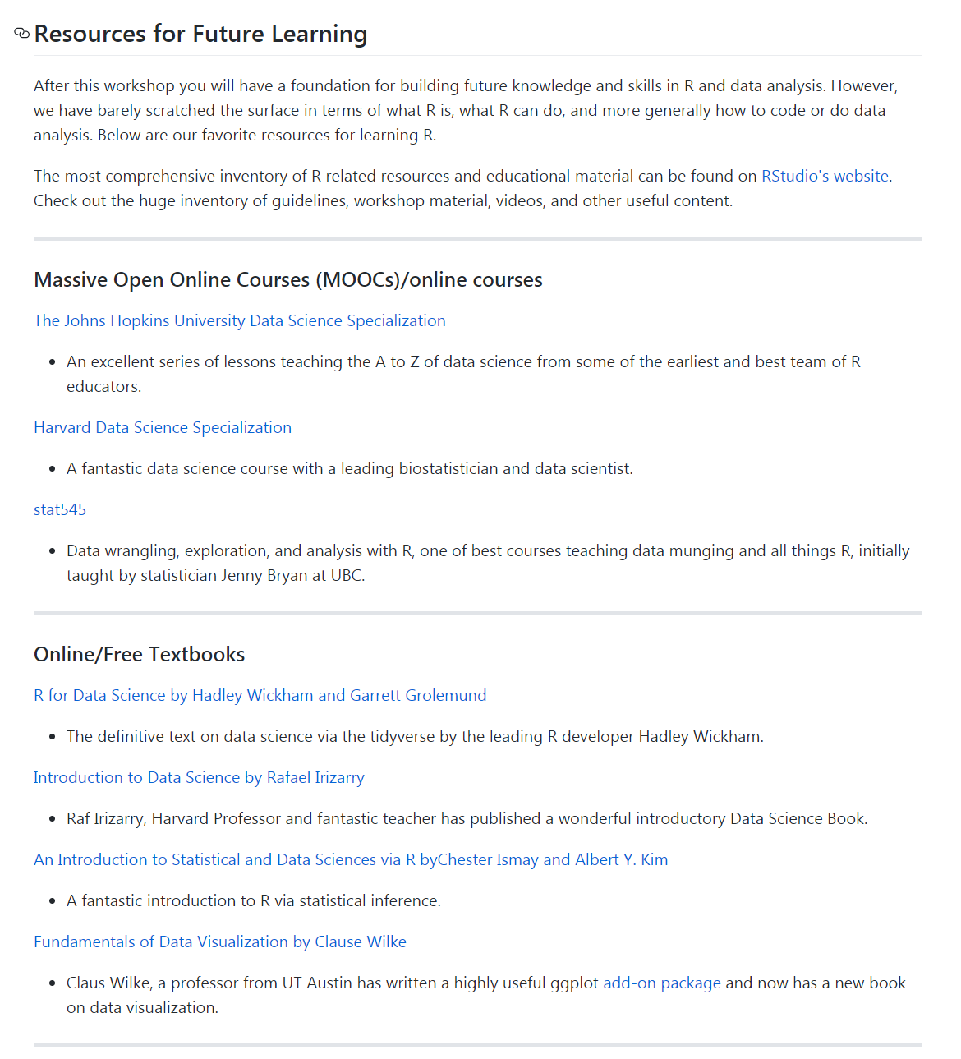
Course Materials
Course Textbook
Slides with course notes
Cheatsheets
Resources
https://github.com/pcmathias/AACC-2019-Introduction-to-R
Notes:
Course textbook and resource list can be found on the github: https://github.com/pcmathias/AACC-2019-Introduction-to-R
RStudio Cheatsheets are available at the RStudio website: https://www.rstudio.com/resources/cheatsheets/

Slide 5
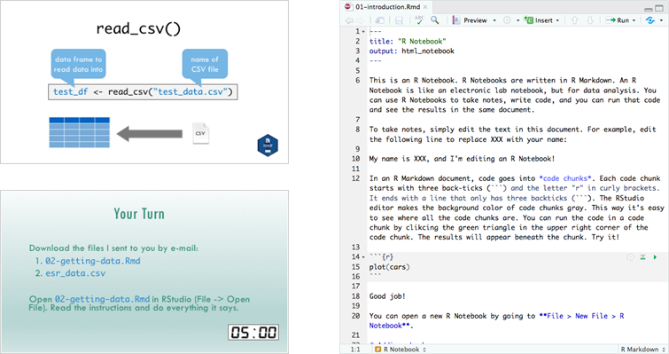
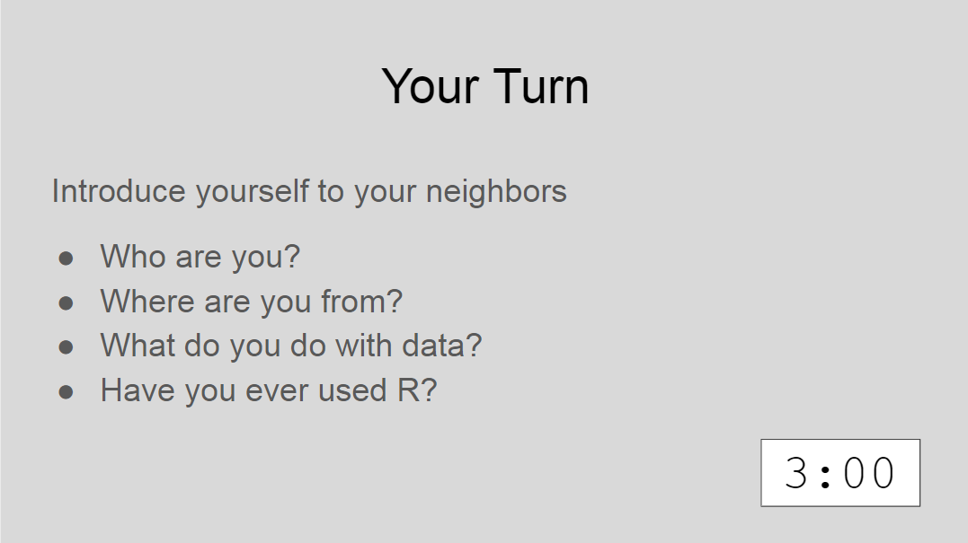
Lectures
Notes:
The lessons are a combination of:
Didactic Material
Interactive Coding Exercises
Live Demonstrations

Slide 6
Tips for Success
Remember that computers are not actually that smart: R will do exactly what you tell it to do, even if that’s not what you want! Your code can’t have errors because R can’t figure out what you mean.
Take the “copy, paste, and tweak” approach: It is often much easier to taking existing code that you know works and modify it to suit your ends, rather than trying to write new code from scratch. Exercise ctrl-C/ctrl-V!
Moderndive.com

Slide 7
Tips for Success
The best way to learn to code is by doing: Find a project, make a goal, and push yourself to use R!
Practice is key!
Moderndive.com

Slide 8
Getting Oriented to R

Slide 9
Lesson Goals
Get oriented to R and RStudio
Learn some fundamentals of coding
Lesson Objectives
Log in and tour RStudio Cloud
Execute code at the console
Define and use functions
Define and create objects in the environment
Interact with a dataframe
Notes:
In this first hour our goal is to develop some familiarity with the R programming language as well as some basic proficiency with coding fundamentals as they are implemented in R.
We will log into the R environment and learn about the how to execute code in the console.
Upon this we will layer concepts of functions and objects. We will use some basic functions and make some objects.
Finally we will access and interact with a dataframe.

Slide 10
What is R?
R is a statistical programming language.
Using R you can load, analyze, and visualize data.
R also provides an environment in which we can conduct reproducible data analysis.
Documented
Revisable
Shareable
Notes:
R is a statistical programming language. It is freely available and has been evolving for > 25 years.
R is popular with statisticians and data analysts. It’s flexible, extensible, and broadly capable for the import, analysis, and visualization data.
R supports everything from linear regression to machine learning.
R also enables us to conduct reproducible analysis that we can document, iterate, and share with colleagues. R is great for those looking to graduate from working with spreadsheets.

Slide 11
RStudio: The Portal to R
RStudio is an integrated development environment (IDE)
Using RStudio we can interact with the R programming language to:
Write and execute code interactively
View data
Debug and fix errors
Author our code
Notes:
A base install of R gives us the ability to write and execute code, but working entirely at the command line isn’t intuitive or efficient.
Most R users choose to leverage an integrated development environment (IDE) for their work. An IDE layers over the R programming language and provides a more streamlined way for us to work with R.
The most popular R IDE is Rstudio. This is the IDE we will be using in this course.
Rstudio provides layers many features onto the basic R command line including the ability to easily view data, identify syntax (code grammar), and debug our code to fix errors.

Slide 12
RStudio: In the Cloud… In Your Home
RStudio Cloud: An online hosted version of RStudio that we will use for these course sessions
RStudio Desktop: A locally installed version of RStudio that you will use when you get home to continue your learning
Note: Use Rstudio Cloud only for this course. Do not upload protected health information to the cloud!
Notes:
For today’s course we plan to leverage RStudio Cloud. RStudio Cloud is an internet hosted version of RStudio which allowed us to prepare an environment and prepopulate it with data, code, and exercises so you don’t have to spend your energy on those pieces.
When you get home, you will likely transition to using a RStudio Desktop which is a locally installed version of RStudio. We suggested that you install the desktop version ahead of this course so you will be ready to continue to learning R when you walk out of the classroom this afternoon and as a fallback in the event that we experience technical challenges with the cloud deployment.

Slide 13
Your Turn #1
Navigate to: http://bit.ly/AACC-R-2019
Enter your log in credentials
Join Space
Make a copy of the Core Exercises for yourself
Notes:
Let’s take a few minutes to get logged into RStudio Cloud.
In the pre-course email, we asked you to create an RStudio log in. Use those credentials now to access the instance.
The following slides show the clicks to copy the workspace.
Raise your hand if you need help.

Slide 14
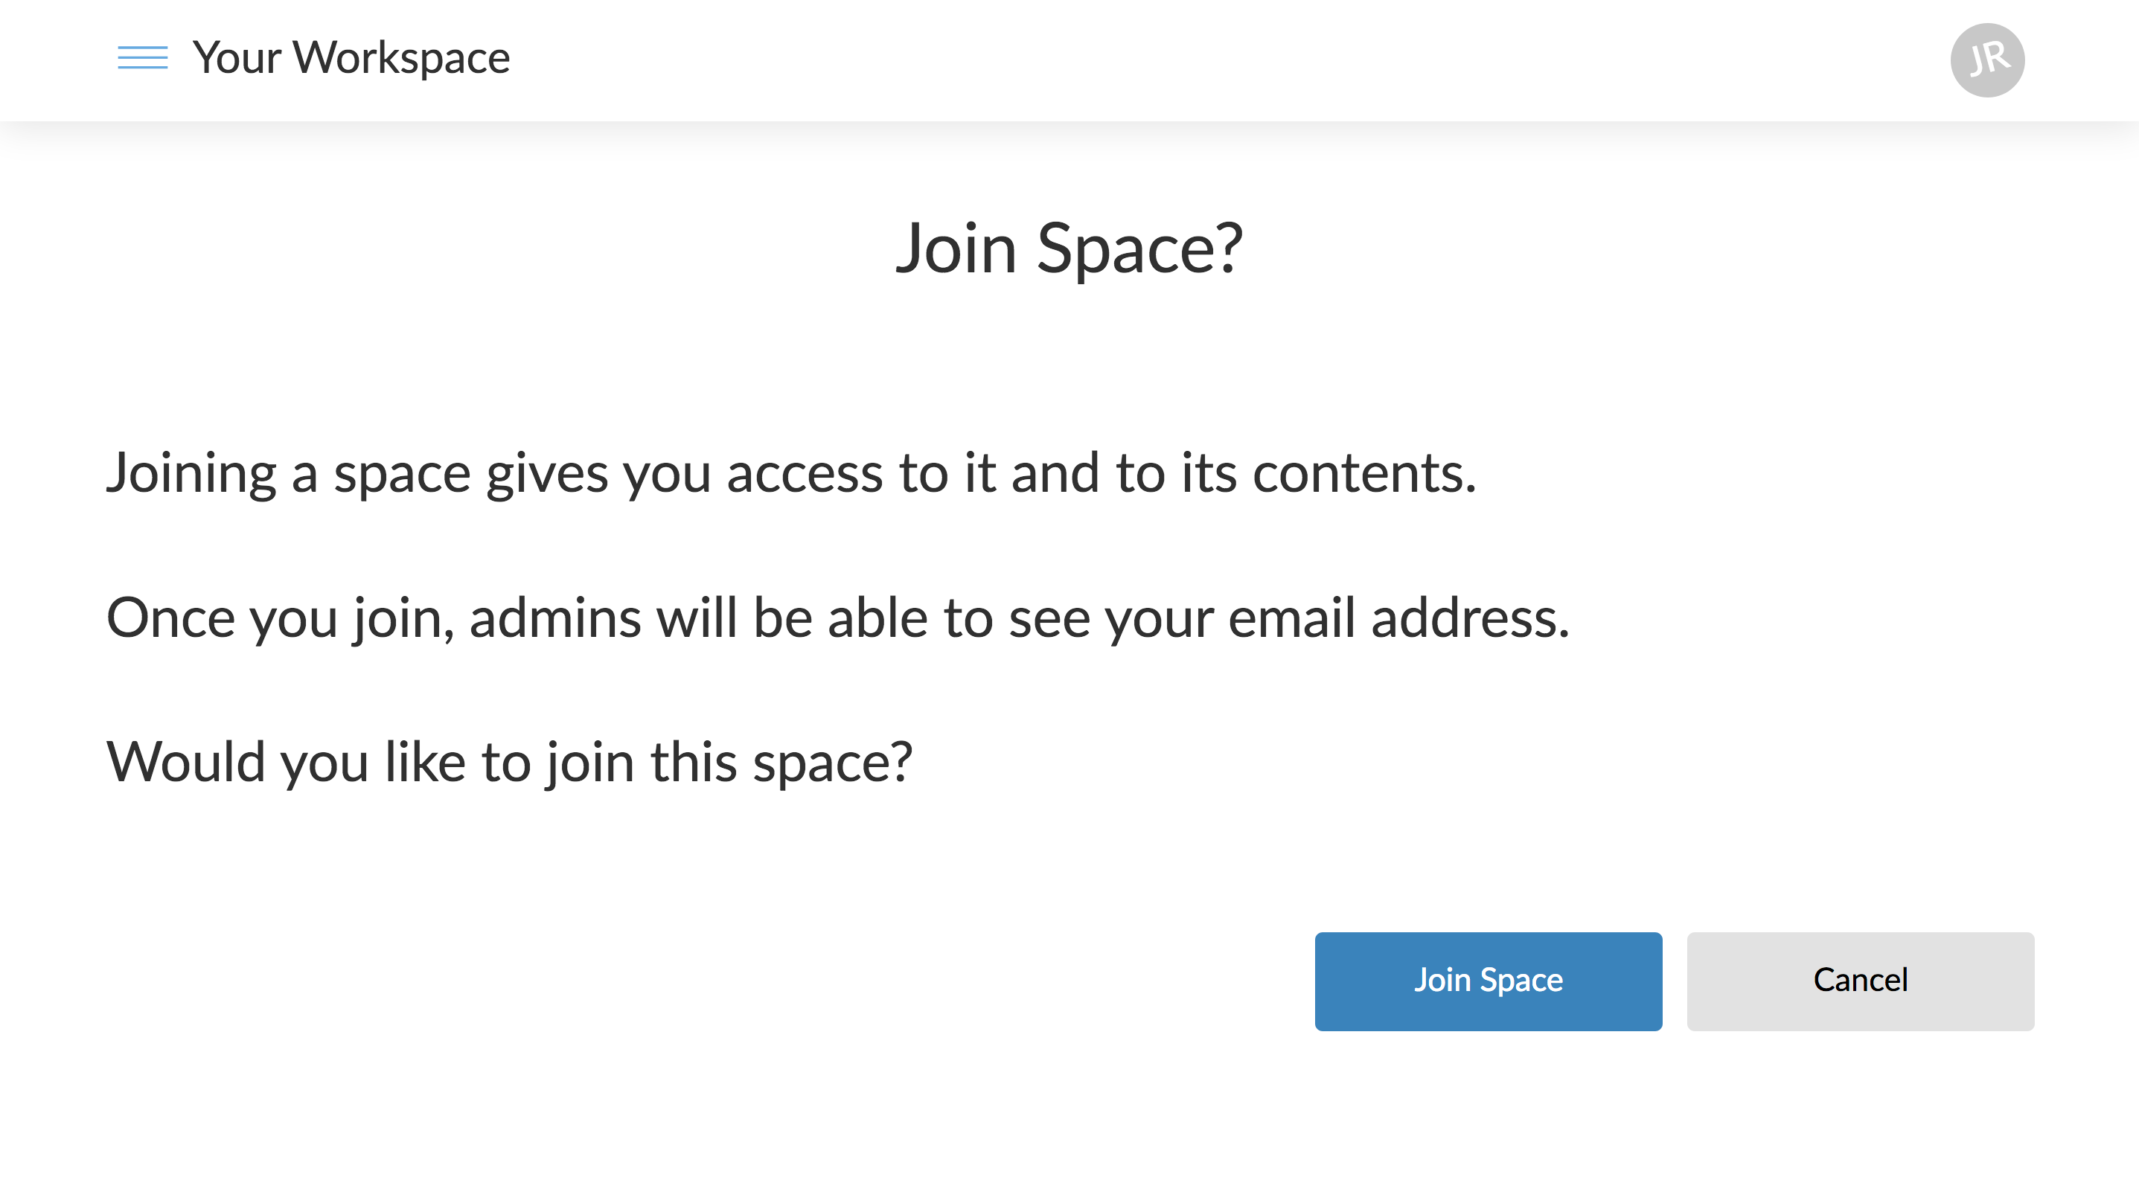
Notes:
Click “Join Space”

Slide 15
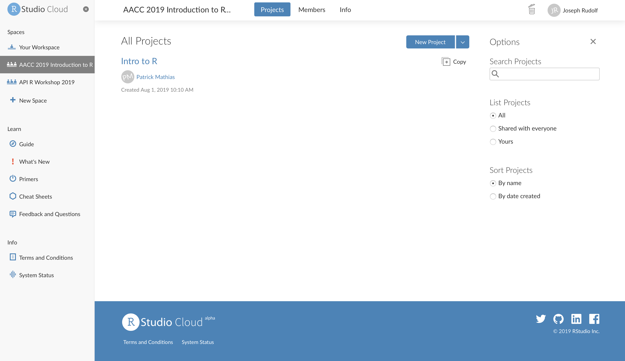
Notes:
Select the workspace “AACC 2019 Introduction to R Programming”
Click “Copy” to create your own version of the core course workspace.

Slide 16
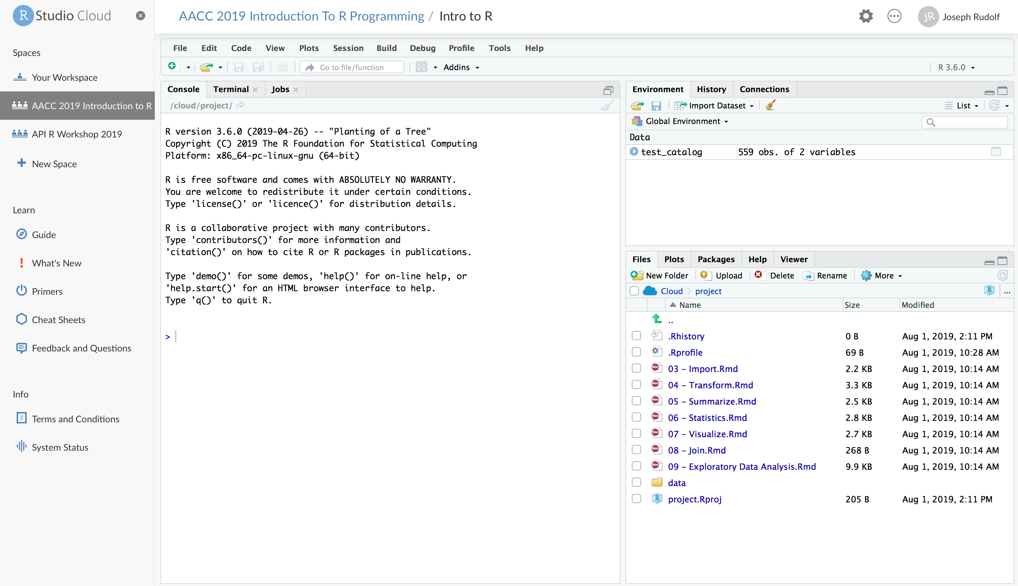
Notes:
Wait for for your version of the project to spin up. Your screen will look like this when the work space is finished loading.

Slide 17
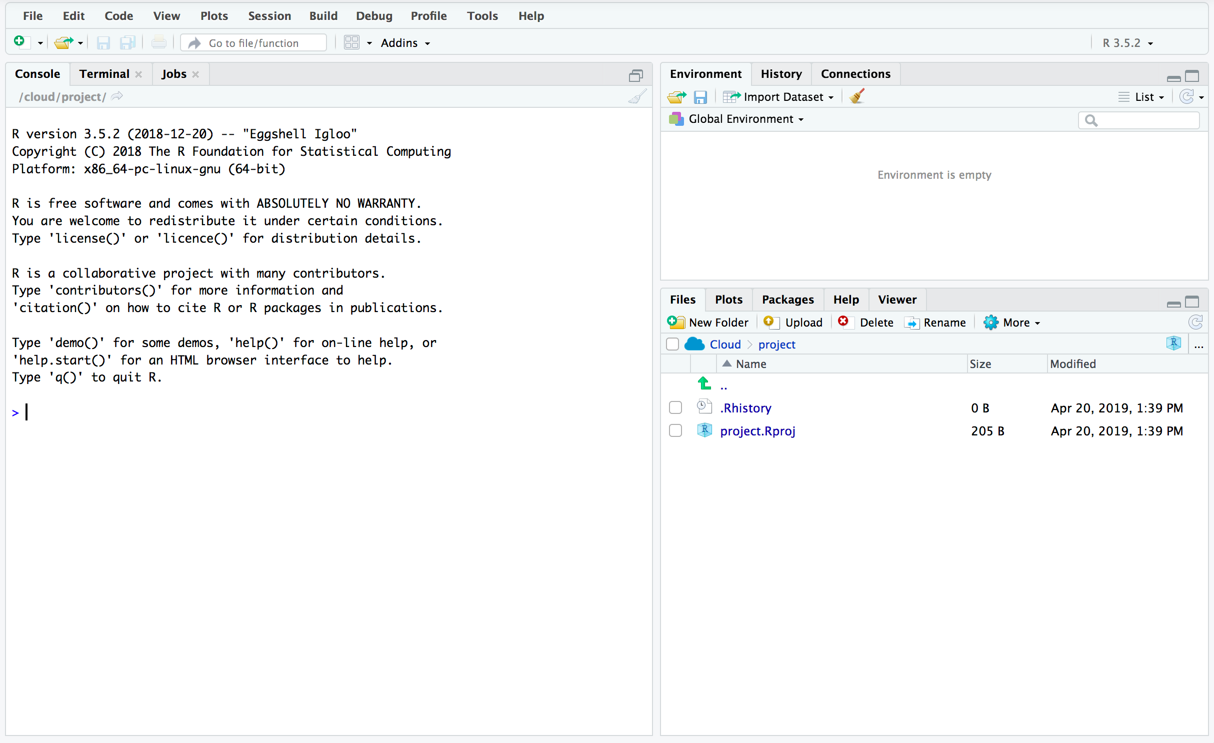
Overview of the RStudio Environment
ENVIRONMENT
CONSOLE
OUTPUT
Notes:
This is the basic RStudio layout.
Console – Where we will enter and execute the code we write in this session.
Environment – Where objects (think variables or containers for storing data) will appear.
Output – Where the output of our visualization occurs. It also has tabs for us to browse file locations and interact with the help documentation

Slide 18
The Basics of Coding

Slide 19
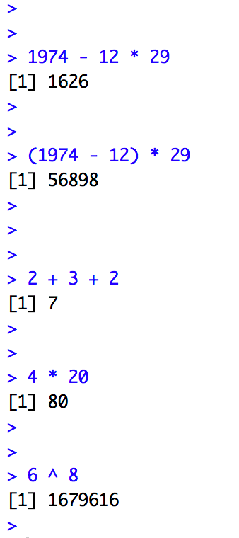
The Basics of Coding: Calculation
R is a calculator!
enter/return to execute code
answer returned here
Notes:
At it’s most basic, R is a fancy calculator.
It supports common mathematical operators
+ add, - subtract
* multiply, / divide
^ exponents
We type our code at the console and use the enter (return) key to execute.
The answer is returned on the following line.

Slide 20
Your Turn #2
Place your cursor at the console and click to enter the console.
Complete the following calculation:
-For the date 12-29-1974
-Take the four digit year
-Subtract the month then multiply by the day
Notes:
Now it’s your turn to do some coding.
Complete the following exercise.

Slide 21
What did you get?
A four digit number? A five digit number?
Order of operations matters!
Notes:
Let’s review our answers.
Order of operations matters
-exponents and roots first
-multiplication and division
-addition and subtraction
Multiplication will occur before subtraction unless we embed our operation in parentheses.

Slide 22
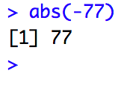
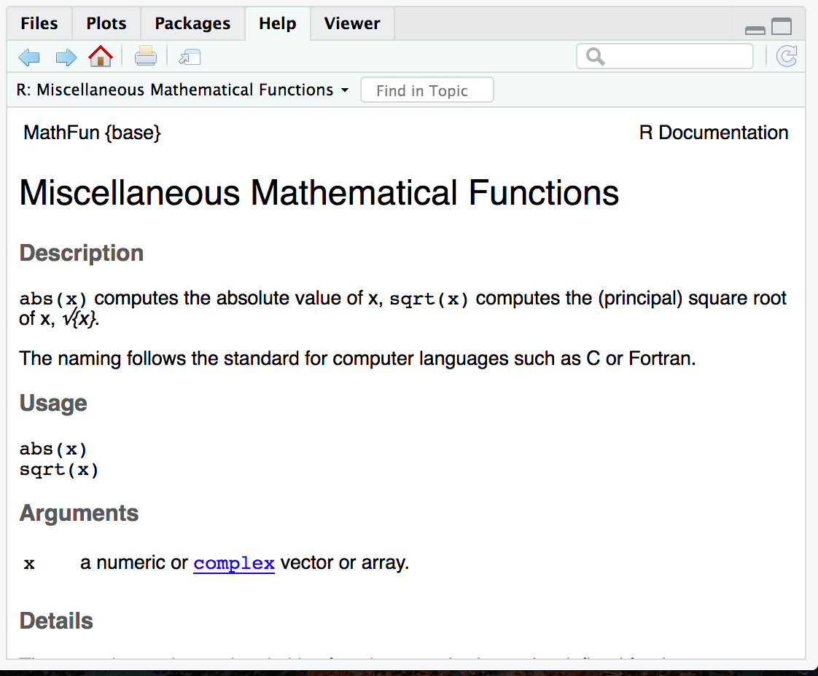
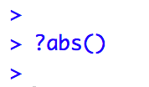
The Basics of Coding: Functions
function
(does stuff)
argument
(input)
Code that extends our reach beyond the basic operators
What if I don’t know what a function does?
abs(-77 )
Notes:
Functions are code that perform actions on our behalf. We can use functions that others have written (or that we write ourselves) to reuse existing code over and over.
Functions accept an argument (input). We use parentheses as the syntax (grammar) to identify the argument(s).
Then the function does its task and provides us with some output, in this case the absolute value of an integer.
The help feature in R is very… helpful! Preceding a function with ? and executing the line will bring up help documentation and will educate us on how to use a function.

Slide 23
Your Turn #3
Launch the help function for seq() using help (?)
Read about the seq() function in the output window
Can you describe what the seq() function does?
Notes:
Now it’s your turn to learn about a function.
Use the help feature to read about the seq() function.
What does the seq() function do?

Slide 24
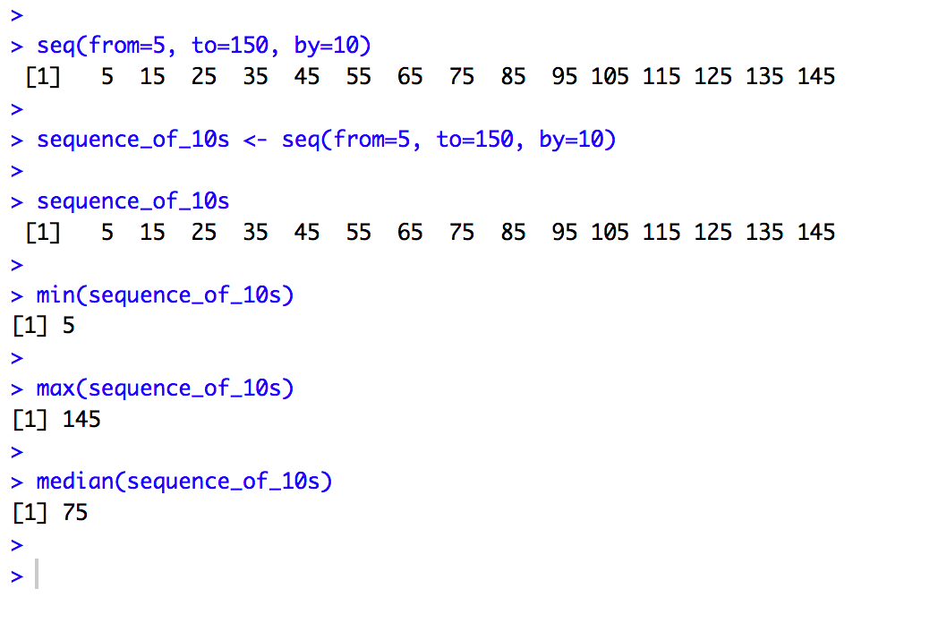
Putting Functions to Work
We can use functions to do more than simple math, we can make things!
We can create a series of integers (a vector) using the seq() function
Notes:
Functions can do more than simple math.
In this case the sequence function seq() accepts arguments defining a start position, a stop position, and an interval, to create a series (a vector) of integers.

Slide 25
The Basics of Coding: Objects
Objects are the vessel for your output
object
(stores output)
function
(does stuff)
arguments
(input)
sequence_of_10s <- seq(from=5, to=150, by=10 )
Notes:
Objects are a very important concept in many programming language.
Objects are the containers in which we can store things for later use.
You can store single values, series, tables, or even names.
In this example we are taking our previous seq() created series and storing it out to an object which we have called sequence_of_10s.
The <- characters are called an assignment operator. They point to the place where we want to store output.

Slide 26
Checking the Contents of an Object
Entering the object name at the console allows us to output the contents of an object.
Notes:
We can call our object at the console by typing the object name and pressing enter/return.

Slide 27
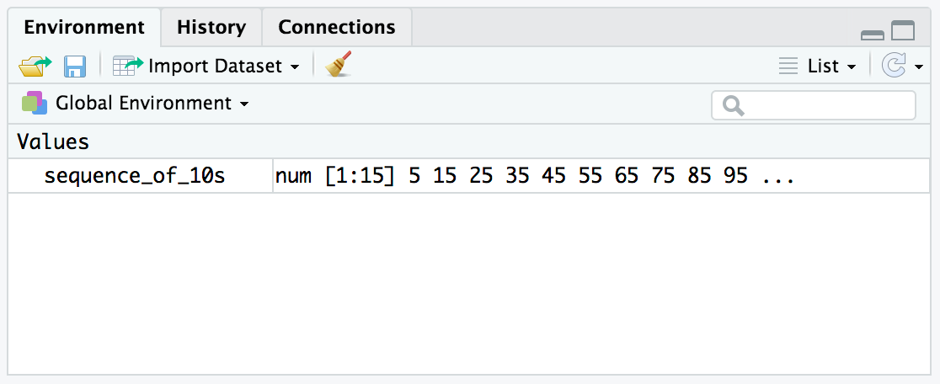
Checking the contents of an object
The environment tab shows us the objects we have created.
Notes:
We can also review our object in RStudio via the environment tab.
When we crate an object in the environment, it will appear in the environment tab and we can review its contents there.

Slide 28
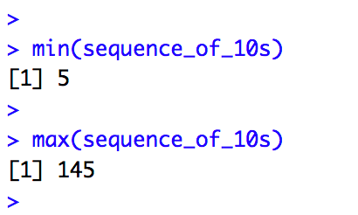
Bending objects to your will
Once we have created an object we can start to interact with it.
This includes passing our objects to other functions… Whoa!
Notes:
Objects are subject to same laws of programming we have learned so far.
We can provides objects as arguments for functions.

Slide 29
Your Turn #4
Generate a sequence, store it to an object, and ply your object*
-use the seq() function to create a vector from 0 to 500 by 25.
-assign your sequence to an object called sequence_of_25s
-check the contents of your object (at the console and in the environment tab)
-use the median() function to find the median value of your vector
*Use the help (?) feature or your neighbor if you get stuck

Slide 30
The Basics of Coding: Packages
A package is a collection of functions.
Packages extend the capabilities of the base R programming language.
The tidyverse includes functions for reading data into the R environment, cleaning and manipulating data, and plotting our results.
Notes:
Packages are collections of functions that extend the capabilities of R. They are written and published by members of the R community.
Packages are hosted on The Comprehensive R Archive Network [CRAN] at https://cran.r-project.org/. There are are 10,000 packages in CRAN, wow!
The tidyverse is an example of a package. It includes specialized functions for reading data, cleaning, data, performing analysis, and visualizing results.
We will make extensive use of the tidyverse in today’s course and encourage you to use it in your own work.

Slide 31

Getting Tidy in the Verse
Being ”Tidy” with your data is important!
Notes:
Developing a tidy philosophy with your data
Basic tidy tenets include: organizing your data in a consistent and standardized way, writing your code in consistent concise language that mimics the English language, and breaking down your analysis into atomic steps.
Here is a figure from the book R for Data Science by Hadley Wickham and Garrett Grolemund. This is an exceptional resource for learning R and data science. It outlines the basic loop of data science: importing data, preparing data for analysis, exploring data, and communicating results. This is the format for analysis we will be using today.
We’ll talk more about this process and tips for being tidy throughout today’s course.

Slide 32
Installing and Loading Packages
Installing a package
Loading into your environment
function
(does stuff)
arguments
(input)
install.packages("tidyverse", dependencies = TRUE)
library(tidyverse)
Notes:
To install packages we use a function called install.packages().
The principal argument for this function is the name of the package, in this example ”tidyverse”.
No need to install this package! It is pre-installed for you in RStudio Cloud. However, if you are using a desktop install of RStudio (now or in the future) you will need to install this package.
When we want to call functions from the tidyverse into our analysis, we need to load the package. We use the library() function.

Slide 33
Your Turn #5
Install a package and load it into the environment
-Leverage the install.packages() function to install a package called ”janitor”
-Load the package into your environment using the library() function.
Notes:
Now it’s your turn to install a package.
Let’s install a package called “janitor” which we will make use of later in the course.
After installation, load the package into your environment with the library() function.
If you have some time after installing the package you can read about it’s function using the help command ??.

Slide 34
Working with Dataframes (aka Useful Data)
Notes:
Vectors are useful, dataframes are even more useful and most closely represent the data we know and love!

Slide 35
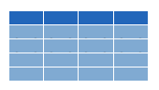


Dataframes: Beyond the Vector
Dataframe is the term for a table
Dataframes are composed:
Columns (Variables)
Rows (Observations)
Dataframes are objects and can be acted on like other objects
csv
xls
db
Notes:
Dataframe is the term we use for a table (think Excel spreadsheet).
Dataframes consists of columns (variables) and rows (observations). This is the tidy way to organize our data.
We can store dataframes as objects and perform actions on them like other objects.
We can get data into R from a variety of file formats (comma separated value files, excel spreadsheets, or directly from databases). This is the import part of data analysis. We will get to importing data in the next hour. For now let’s work with an object that we have prepopulated in the cloud environment.

Slide 36
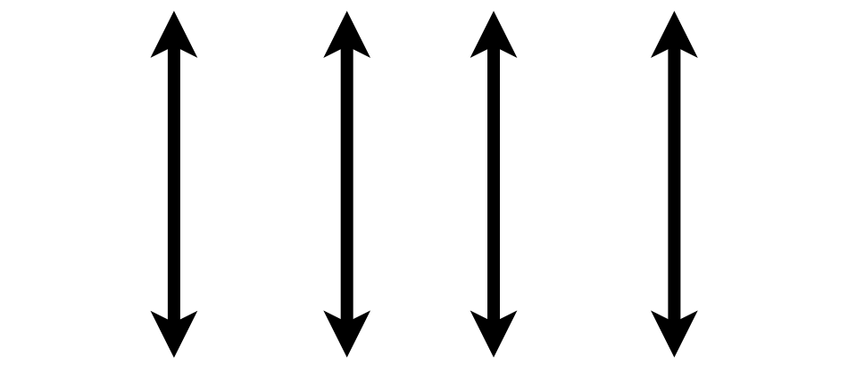

What is a “Tidy” Dataframe?
A data set is tidy if:
Each variable is in its own column
Each observation is in its own row
Each value is in its own cell
Notes:
This is a good time to review the idea of ”tidy” data that also gives the “tidyverse” its name.
Any data set can take on a lot of different shapes. But there is one shape that is best suited for data analysis, and that shape is called ”tidy.”
The opposite of “tidy” data is often called “messy” and often times one of the first data analysis tasks is to convert “messy” data into “tidy data.”
A data set is tidy if: each variable is in its own column,
Each observation is in its own row
Each value is in its own cell

Slide 37
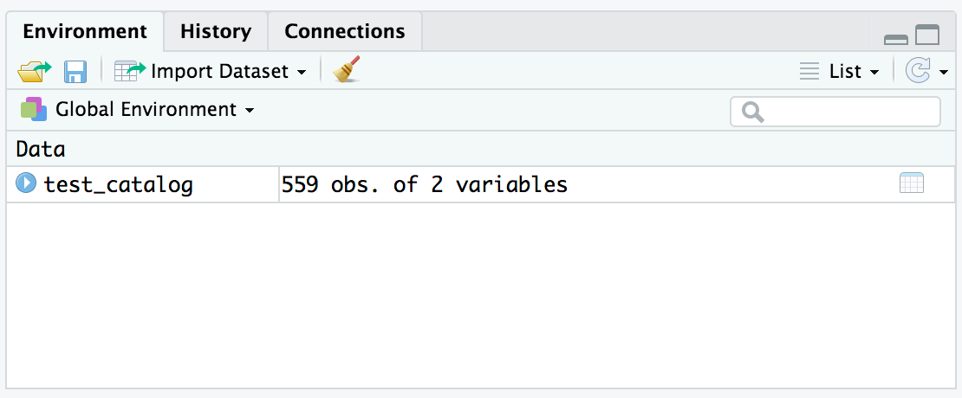
Viewing the Contents of a Dataframe
We have already loaded a data frame called test_catalog.
single click to explore the data
Notes:
Let’s look at a simple dataframe that we have preloaded into the environment.
In our environment tab you will find an object called test_catalog. This object is derived from a larger data set we will be using for the remainder of the course.
We can single click this object to visualize its contents.

Slide 38
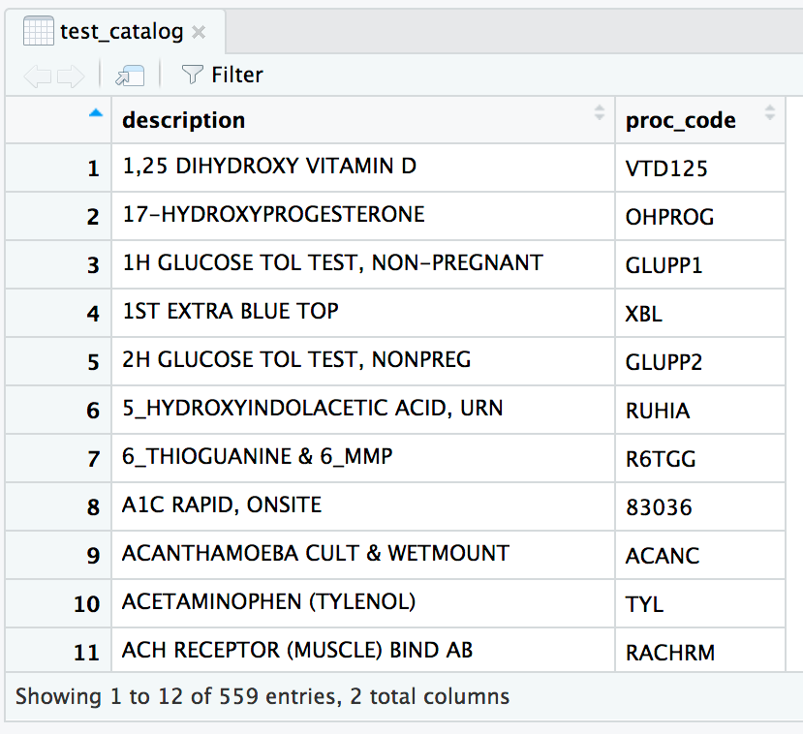
Viewing the Contents of a Dataframe
2 Attributes (Columns)
559 Observations (Rows)
Notes:
This data frame consists of 2 attributes and 559 observations.
The variables are a description (test name) and proc_code (test code).
After exploring the data in the dataframe we can close it by selecting the “x” in the tab at the top left of the pane.

Slide 39
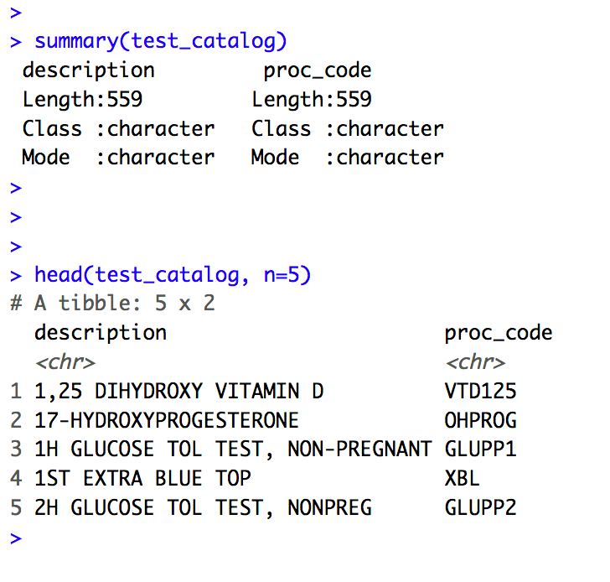
Working with Dataframes at the Console
The summary() function provides you with some abbreviated metadata about your dataframe.
summary(object_name)
Number of Observations (Rows)
Attributes (Columns)
Data Type
Notes:
There are also functions which allow us to quickly explore a dataframe.
If we provide an object name as an argument to the summary() function, we can quickly learn about the attributes in our data set, the number of observations, and they data type of the attribute (more to come on data types later in the course).

Slide 40
Working with Dataframes at the Console
The head() function is helpful for displaying a snippet of your dataframe
head(object_name, n=number of rows to view)
Sample of Data in Your Object
Notes:
As your data sets grow in size and complexity, the environment tab becomes unwieldly for interacting with objects.
For speed and efficiency, you can render a quick looks at your dataframe using the head() function. The arguments for this function are the name of the object, and the number of rows you want to view, in this example we asked for the top 5 rows of the data frame.

Slide 41
Your Turn #6
Summarizing Dataframes and Understanding Object Contents
-Use the summary() function on our object test_catalog
-Leverage the tail() function to review the last 10 rows of the data frame.
-What is the 10th test from the end of the table?
Notes:
Your turn again!
Let’s use our knowledge of the head() function and apply it to the end of the table using the tail() function.

Slide 42
Taking the Leap to Visualization

Slide 43
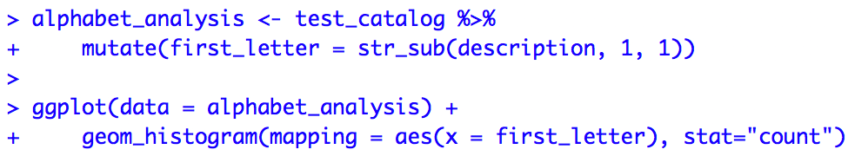
Even Simple Dataframes Can Be Interesting
With a few lines of code we can turn our test catalog…
Identify First Letter in the Test Name
Make a histogram of the Data
Notes:
This is a very simple dataframe but can still yield interesting observations.
With a few lines of code we can render a visualization of our dataframe.
Don’t worry about the details of the syntax at this point, we will unpack these functions and concepts (rename(), ggplot(), etc.) throughout the day.
This code takes our test_catalog, isolates the letter that the test names start with, counts the test names by their first letter, and outputs a bar plot of the analysis.
One quick syntax tip: the $ symbol specifies a column from a dataframe in the following format: dataframe$column.

Slide 44
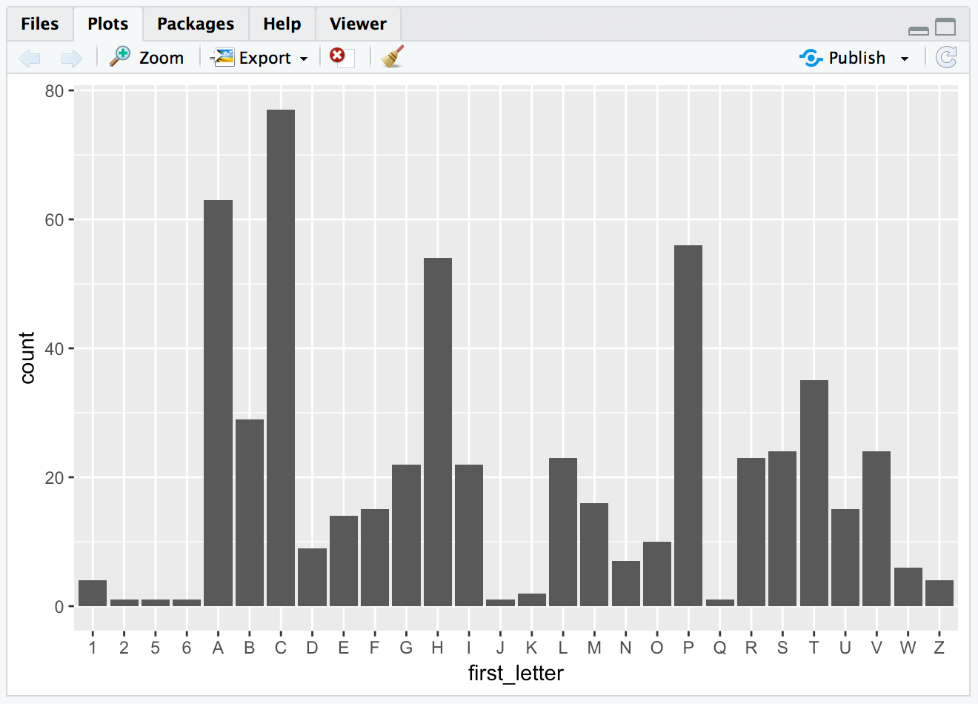
Into an insightful visualization
Notes:
Our bar plot appears in the environment tab.
In our test_catalog, test names commonly start with the letters “C”, “A” and “P”, and very infrequently with letters like “Q”, “J” and numbers. That makes sense!

Slide 45
Console… I only just knew you
As the complexity of our coding increases, the ability to iterate our lines of code as we write becomes apparent
We find it increasing difficult to manage the names and states of objects in our environment
And the console shows us its limitations
Notes:
This is a relatively straightforward analysis, but even this is unwieldly to develop at the console.
It’s easy to get confused about which objects you have created and what their contents are when developing at the command line. It’s also easy to accidentally overwrite the contents of an object without realizing it, further muddying the environment.
Within a couple hours of learning to program in R, you may start to get frustrated with the command line.

Slide 46

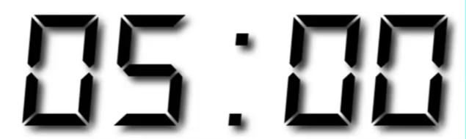
A Hero is Born
Hi! My name is Mark Down and I am here to save earth from non-reproducible reporting.
Notes:
Luckily there is a better way!
And this is what we will explore in the second hour.
But first let’s take a couple minutes to stretch. You’ve earned it!

